Slide 1

Computer Vision
Raoul Grouls

Slide 2
Table of content
Motivation
Convolutional network components
Training
CNN architectures
Image classification
Semantic segmentation
Object detection
Instance segmentation

Slide 3
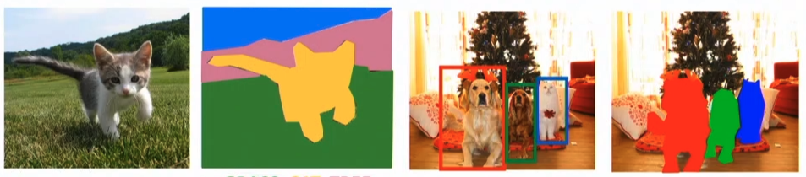
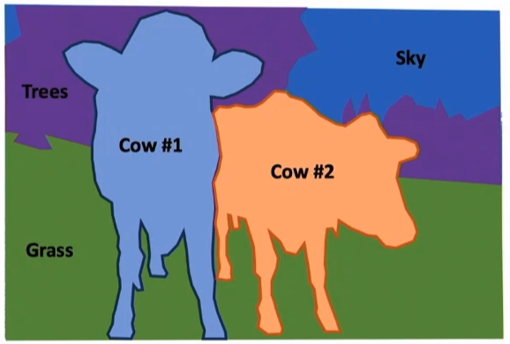
Computer vision tasks
Image Classification
Semantic Segmentation
Object Detection
Instance Segmentation
Panoptic Segmentation
Classify image
Classify every pixel into a category
Classify multiple objects on an image and localize them
Classify multiple objects on an image, localize them and make pixel-wise object mask
Instance segmentation for “things” and semantic segmentation for “stuff”
Notes:
Panoptic Segmentation won’t be in this presentation
But one possible method for it is this: https://arxiv.org/abs/1901.02446

Slide 4
Motivation for Convolutional layer
Preserve spatial structure
We have been flattening the image (eg 28x28) into one vector (eg 784). With this, we destroy a lot of spatial information.
Idea: Don’t flatten the image to one vector, but process the ‘context’ of a pixel.
Nearby pixels will stay nearby
Translational invariance
If you shift the position of an object, it still means the same thing
A cat in the right corner of the image is also a cat in the left corner
So we want to share parameters

Slide 5
More and more complex features
First layers more simple features
Latter layers more complex features

Slide 6
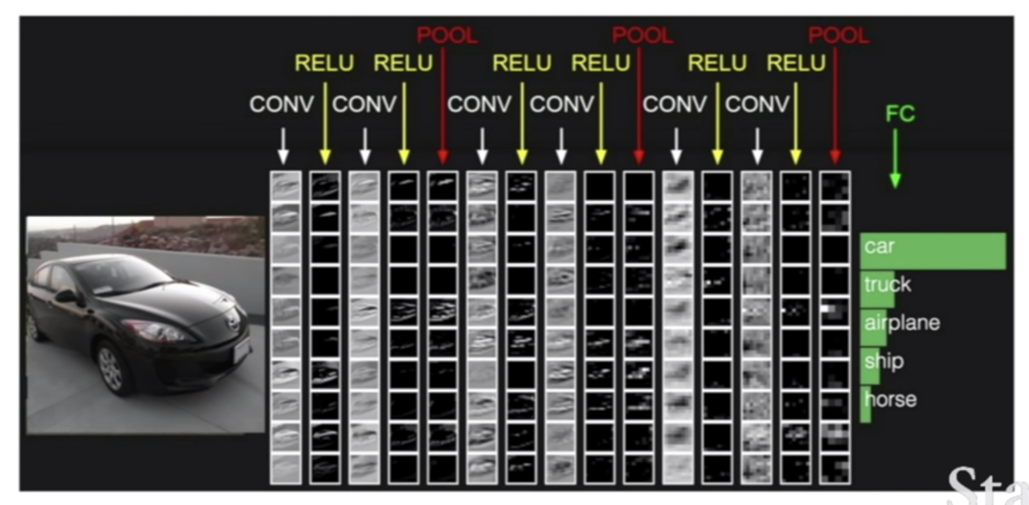
Basic Convolutional network structure

Slide 7
convolutional net components

Slide 8
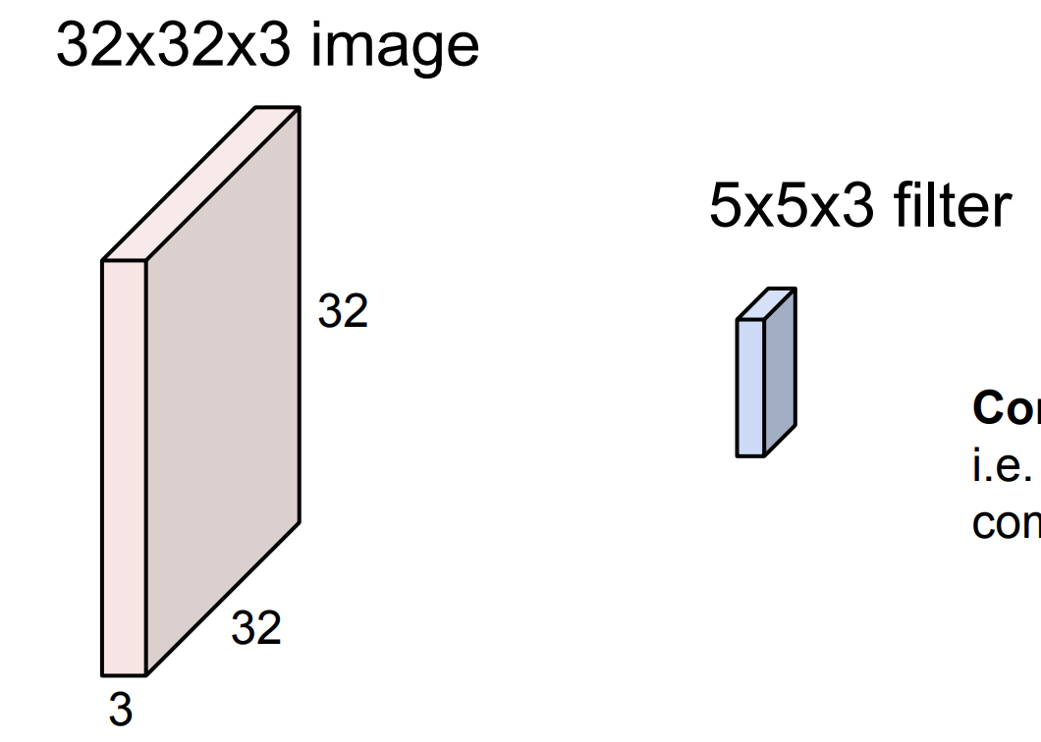
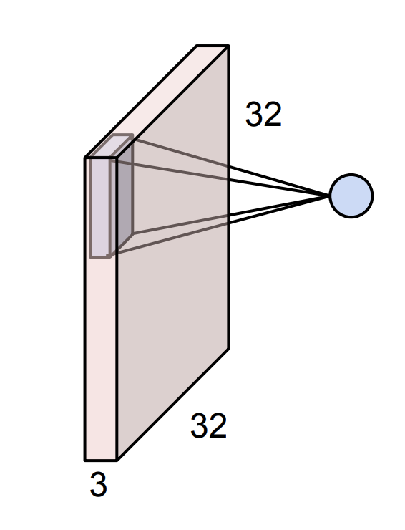
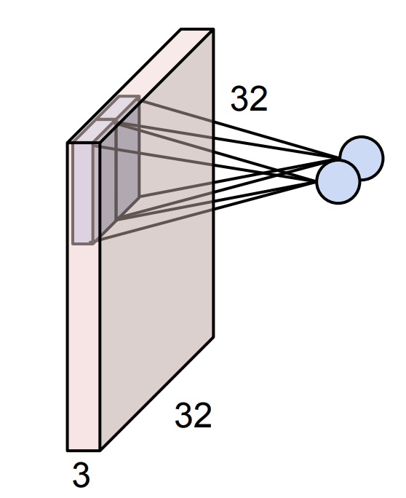
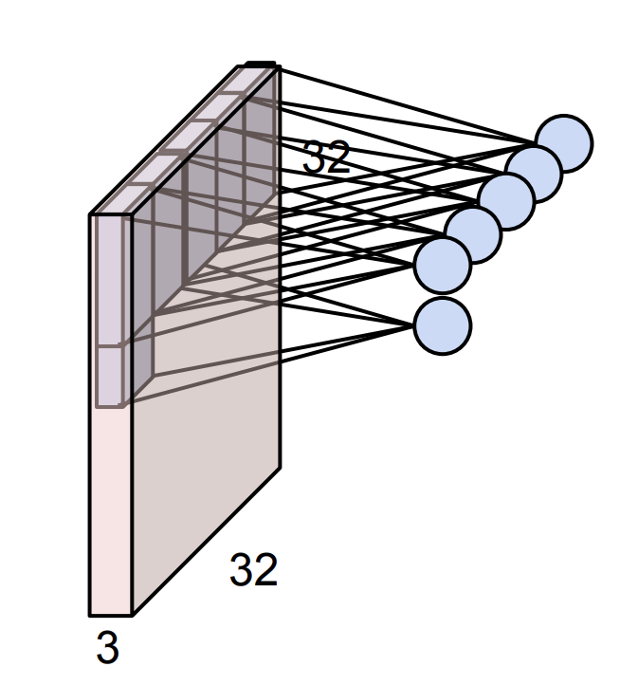
Convolutional layer
Take a filter
Slide over every position of the input
Notes:
Channel number = depth of input

Slide 9
Convolutional layer
Calculate the dot product between the filter and input segment the filter covers
Arrange result of the dot products in a 2D array, yielding the output activation map
The activations in the activation map should reflect the positions of the filter, when the dot product was calculated
Notes:
Channel number = depth of input

Slide 10
Convolutional layer
The filter goes through the entire depth of the input
Parameters in filter: (width, height, channel number)
In case of first hidden layer, the channel number is 3, representing the RGB colours
Notes:
Channel number = depth of input

Slide 11
Convolutional layer
Later on, the channel number represents the amount of filters that produced feature maps.
So, we could end up with small feature maps (eg 5x5 pixels big) but we might have 512 of those.
Notes:
Channel number = depth of input

Slide 12
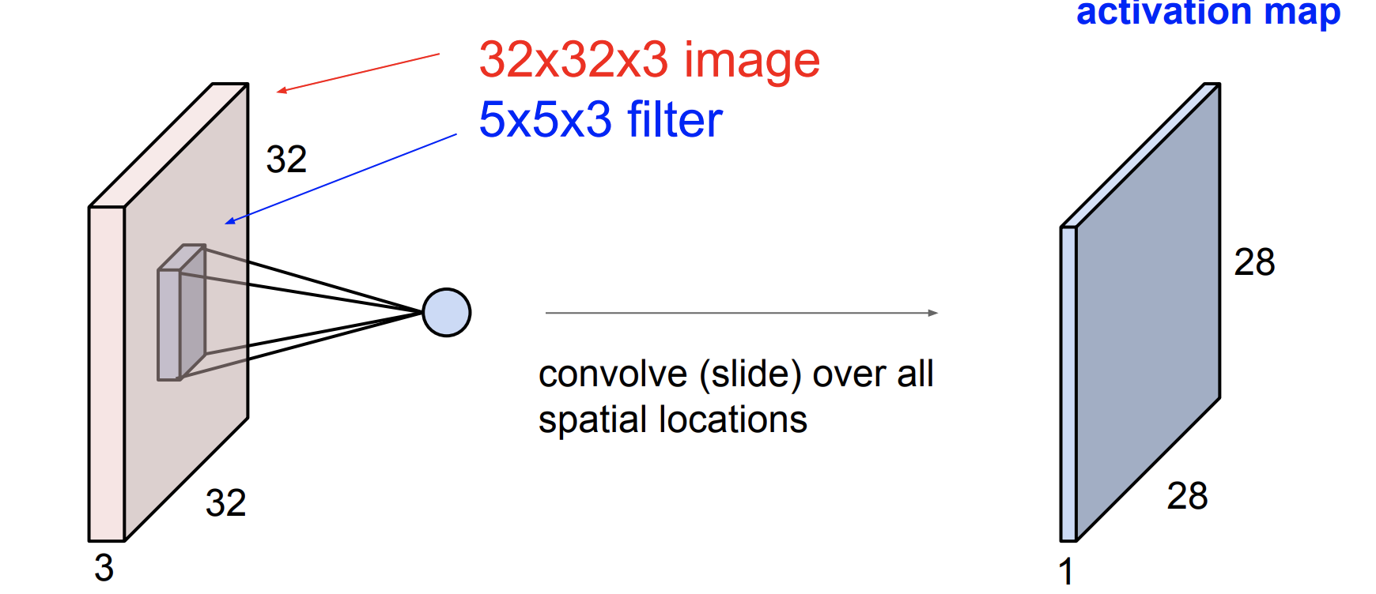
Convolutional layer

Slide 13
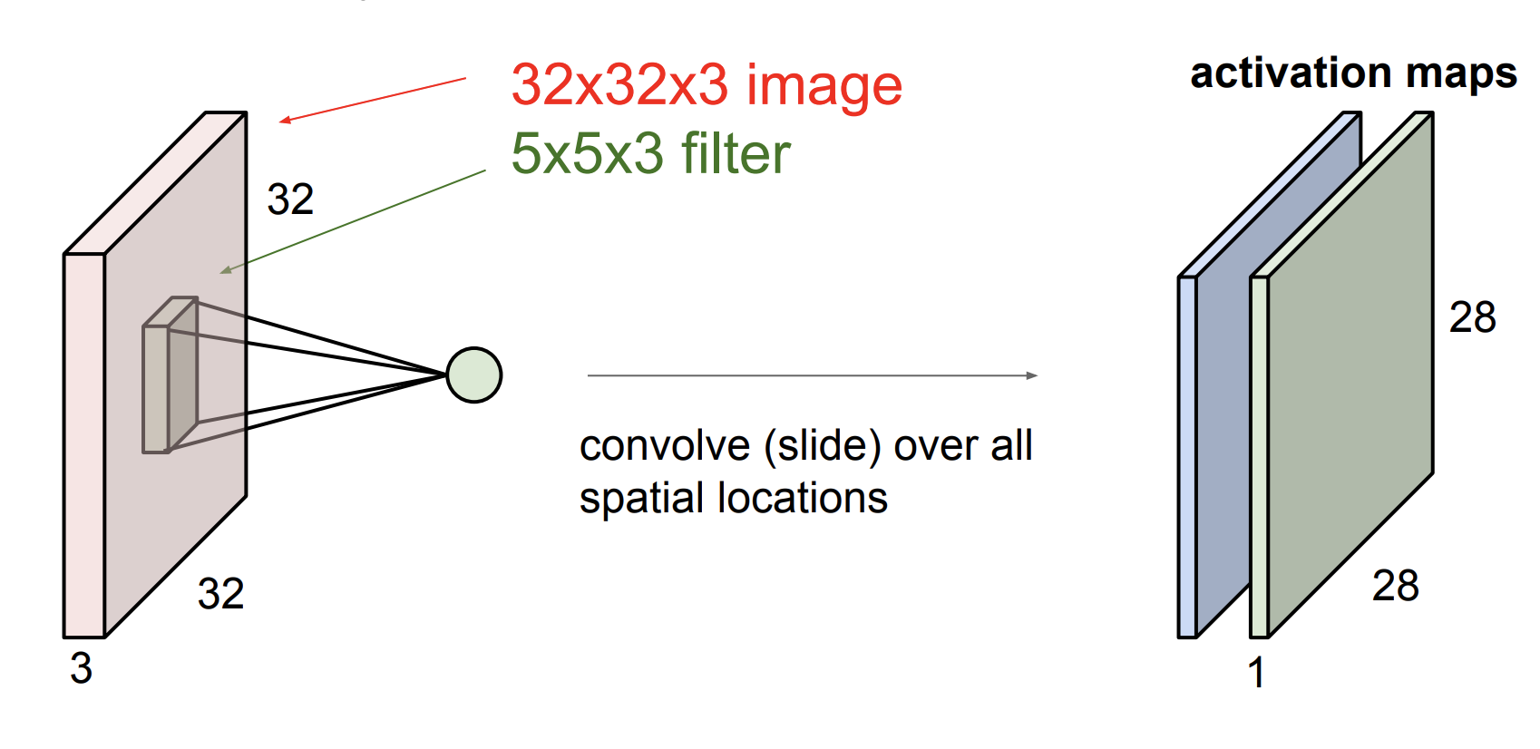
Convolutional layer
Notes:
For one input (either image or activation map), multiple different filters can be applied
Each filter will create a new activation map
The activation maps are stacked together
The depth (number of channels) in the activation map will be the number of filters applied

Slide 14
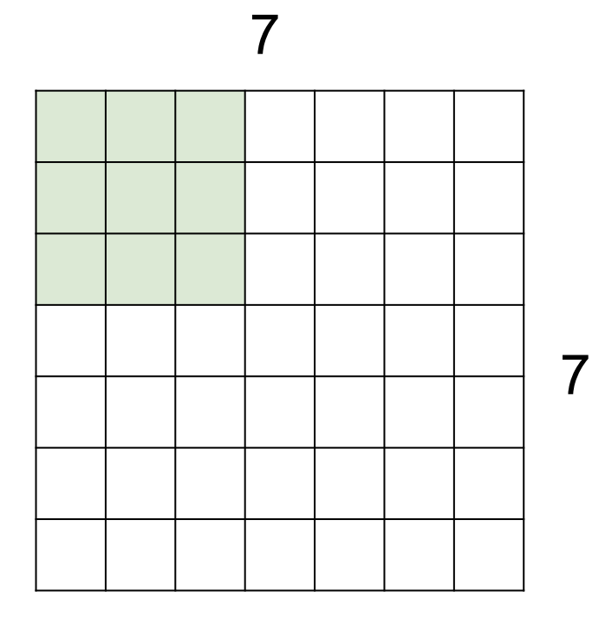
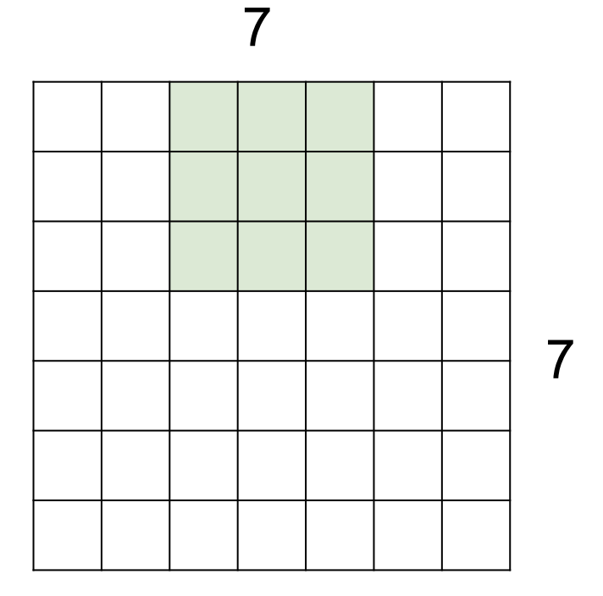
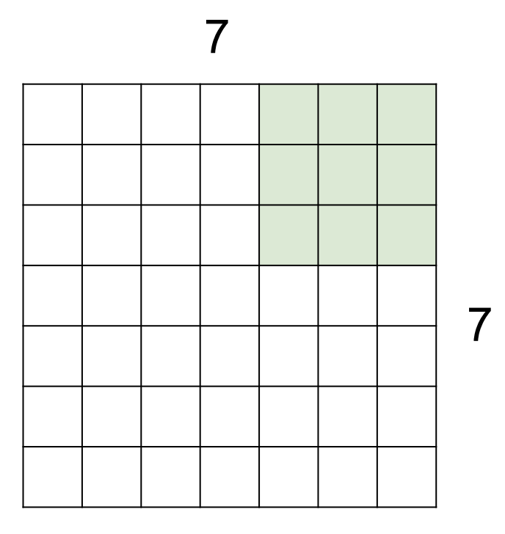
stride
Stride: how many pixels to step when sliding the filter
Shrinks the output dimensionality, if stride > 1
If stride is 2, dimensionality is approx. halved

Slide 15
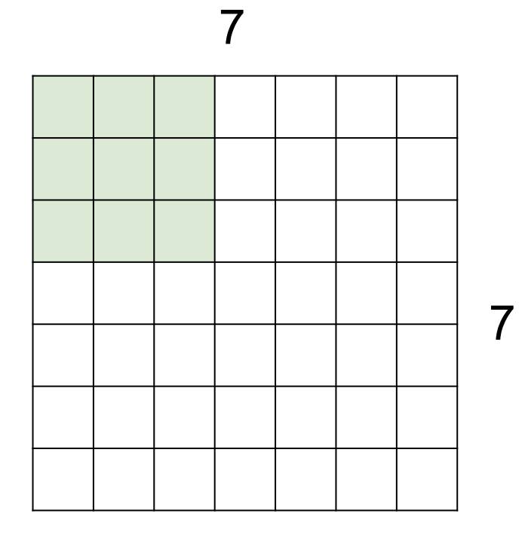
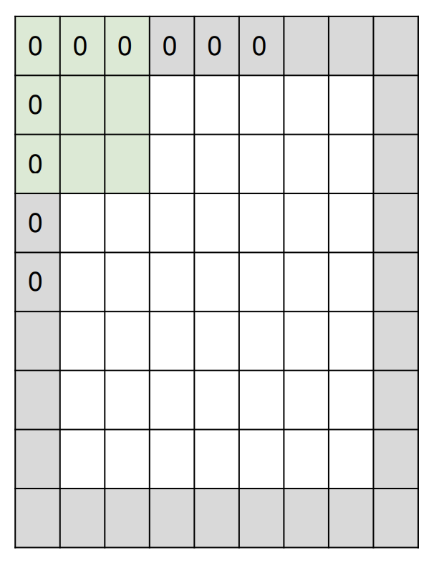
padding
No padding
Then slide as far as we can, ignore the last pixels if one more filter does not fit
Output size will be smaller than input size
Padding
Then filter can slide out of the image
Output size will be the same as input size
Why: because otherwise for a deep network the activation layer would shrink very quickly
Notes:
Example on images:
No padding: (5x5) -> (7x7)
Padding: (7x7) -> (7x7)

Slide 16
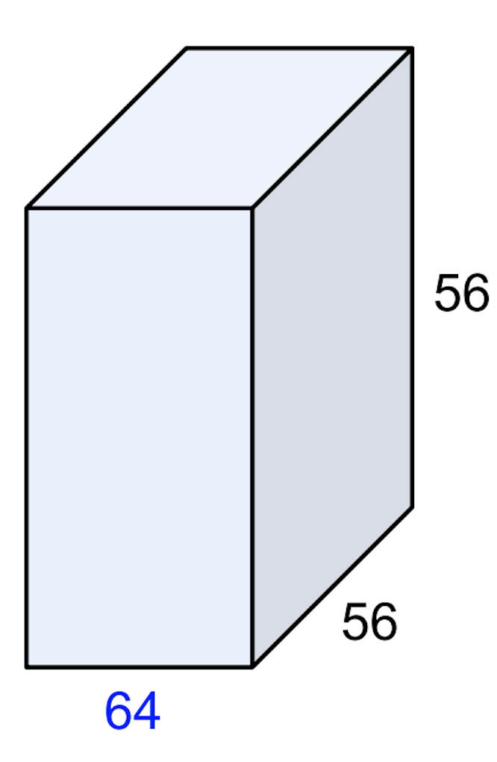
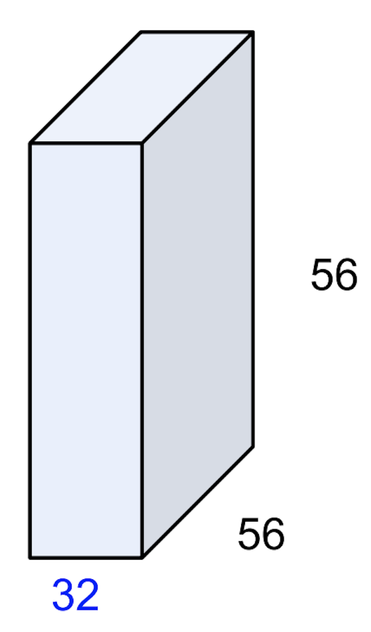
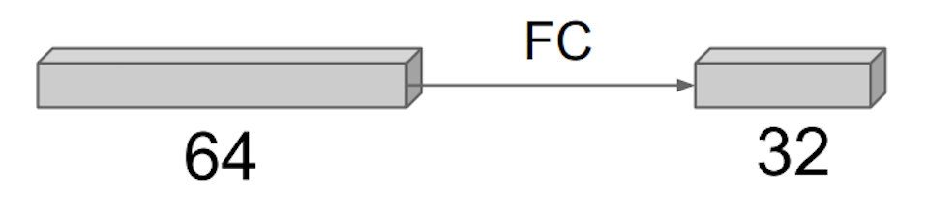
1X1 convolutional layer
A fully connected layer in between channels
Weights are shared in between all spatial positions
Preserves spatial dimensions
Can be used to reduce the number of channels
“Bottleneck layer”

Slide 17
Convolutional layer design choices
Number of filters
Filter spatial size
Stride
Padding

Slide 18
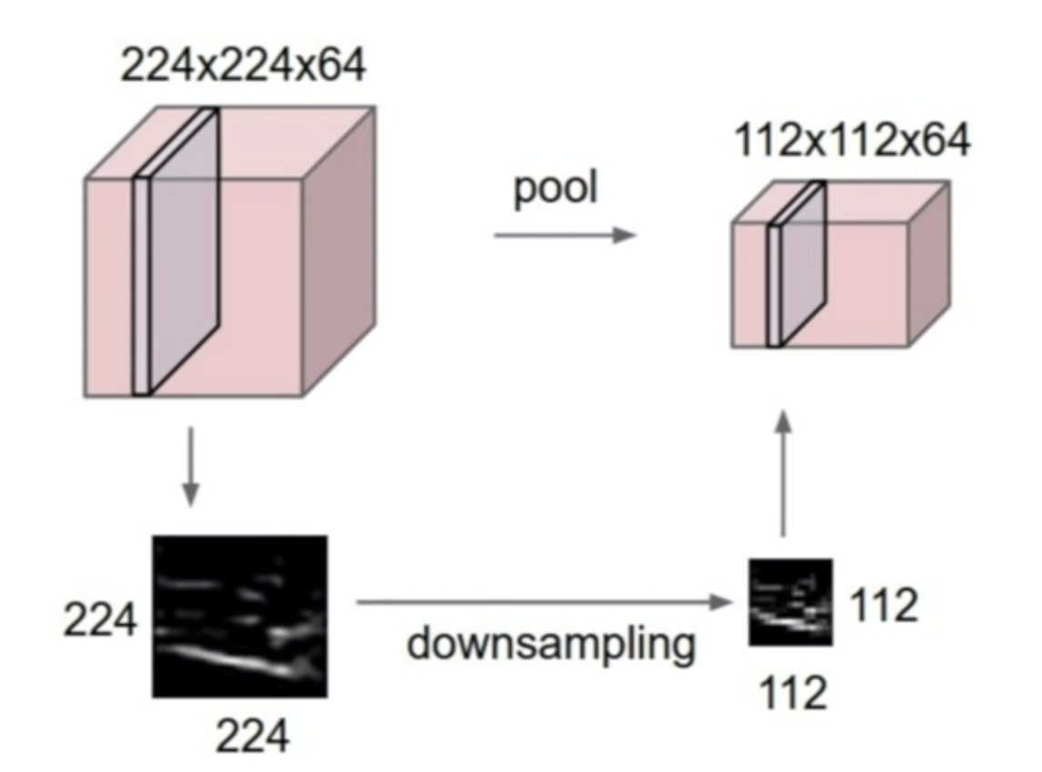
Pooling
To downsample the input
Swipes through the input and performs the aggregating operation
Does this in every channel independently
Doesn’t effect depth dimensionality, unlike the convolutional layer

Slide 19
Pooling
Pooling, or convolution with stride 2?
Contains no learnable parameters
Introduces some translational invariance
But sometimes conv with stride > 1 works better, and some architecturs remove maxpooling altogether in favor of stride=2

Slide 20
Pooling types
Max
Intuition: If there was any high feature value in the area, we only care about that, not the other values
More translational invariance
Average
Intuition: Makes a more smooth downsampling
Keeps the spatial structure more
Usually max is preferred over average pooling

Slide 21
Pooling design choices
Filter size
Stride
Type
Max
Average
Common settings
Max, F=2, S=2
Max, F=3, S=2
Notes:
F=2, S=2 -> halves image size

Slide 22
Fully Connected layers, softmax
Flatten the last activation maps into a single 1D vector
The output layers should either use a softmax for classification, or use no activation at all.
Softmax turns the logits (ranging from –inf to +inf) into a probability distribution (positive numbers that add up to 1 over all the output neurons)
If you don’t use a softmax, you should set from_logits=True in your loss function.

Slide 23
Training

Slide 24
Transfer learning
Sometimes you overfit, because you don’t have enough data
Idea: Pretrain model on a large generic dataset, then refine on your problem specific data set
Motivation: the features that the model learned from pretraining will be generic, and useful for your data set

Slide 25
Transfer learning
Strategies
Pretrain and freeze
Freeze weights, except from last layer(s)
Train last layer(s) with your specific dataset
Pretrain and refine (can be a second step)
Don’t freeze weights, just refine with your data
Keep the learning rate low, for refining training
The less data you have the smaller part of the model to refine (for very few data, only the last layer)
Transfer learning (pretraining) nowadays is a norm, not an exception

Slide 26
Data augmentation
Idea: randomly transform the image
Reasoning:
Free way of generating new training data
Acts as a regularization
NN doesn’t see the same pixel combination over and over again
Transformations
Flip
Scale
Crops
Change contrast, brightness
Colour jittering
Salt and paper
Cutout (cover parts of the image with black rectangle)

Slide 27
Cnn architectures image classification

Slide 28
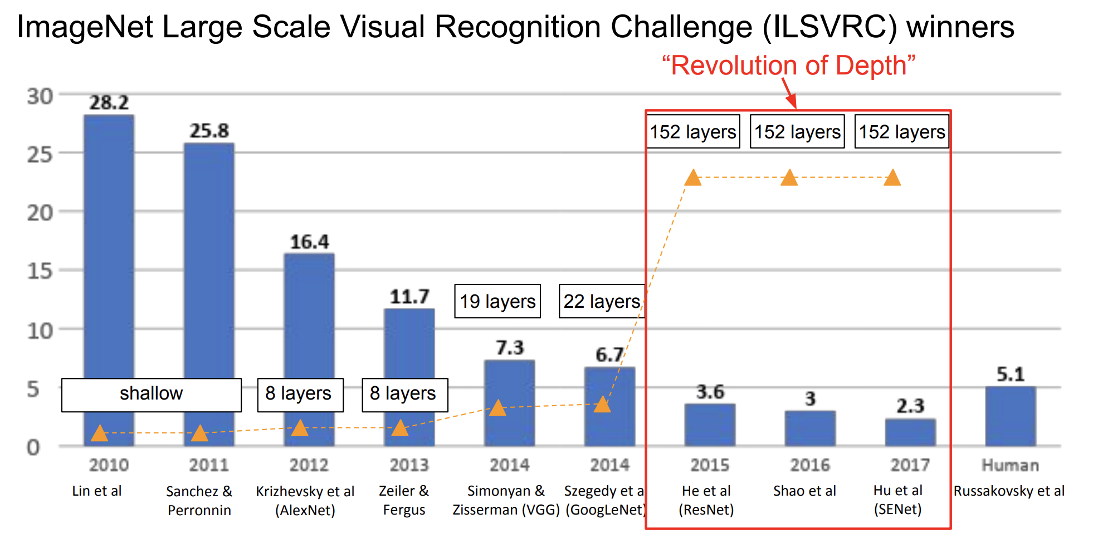
Cnn layer numbers

Slide 29
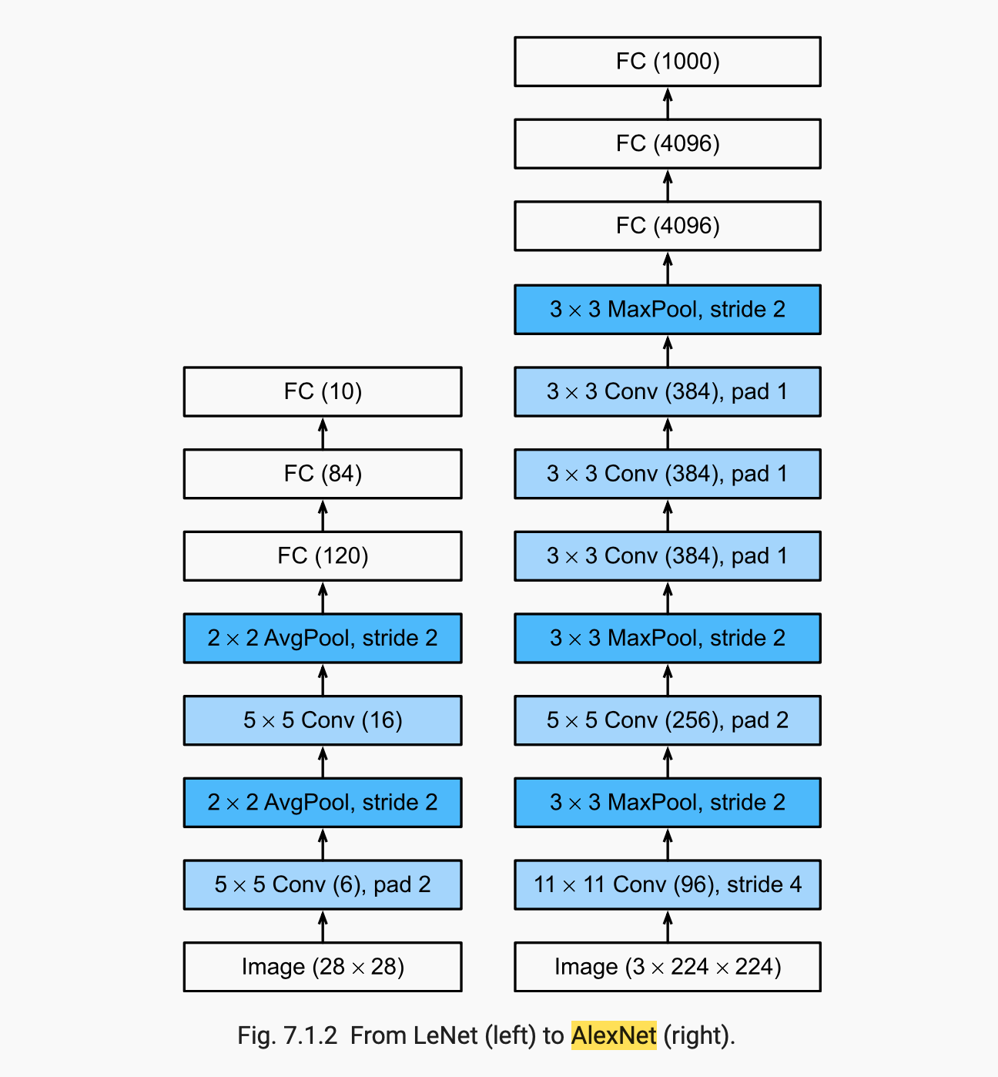
LeNet and alexnet

Slide 30
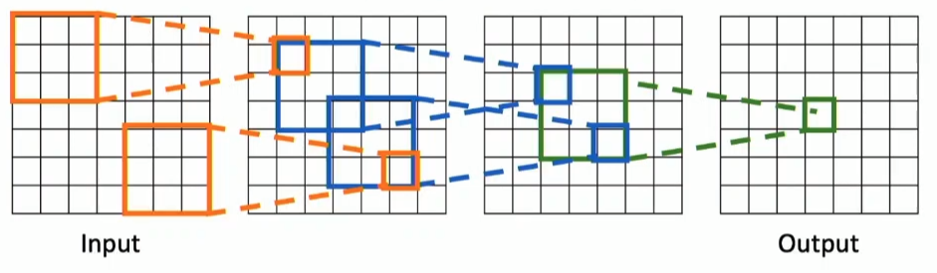
Effective receptive field
Effective receptive field is the total area of inputs, a set of layers is looking at combined, to calculate one element of the activation map
The effective receptive field of 3 stacked 3X3 filters is 7

Slide 31
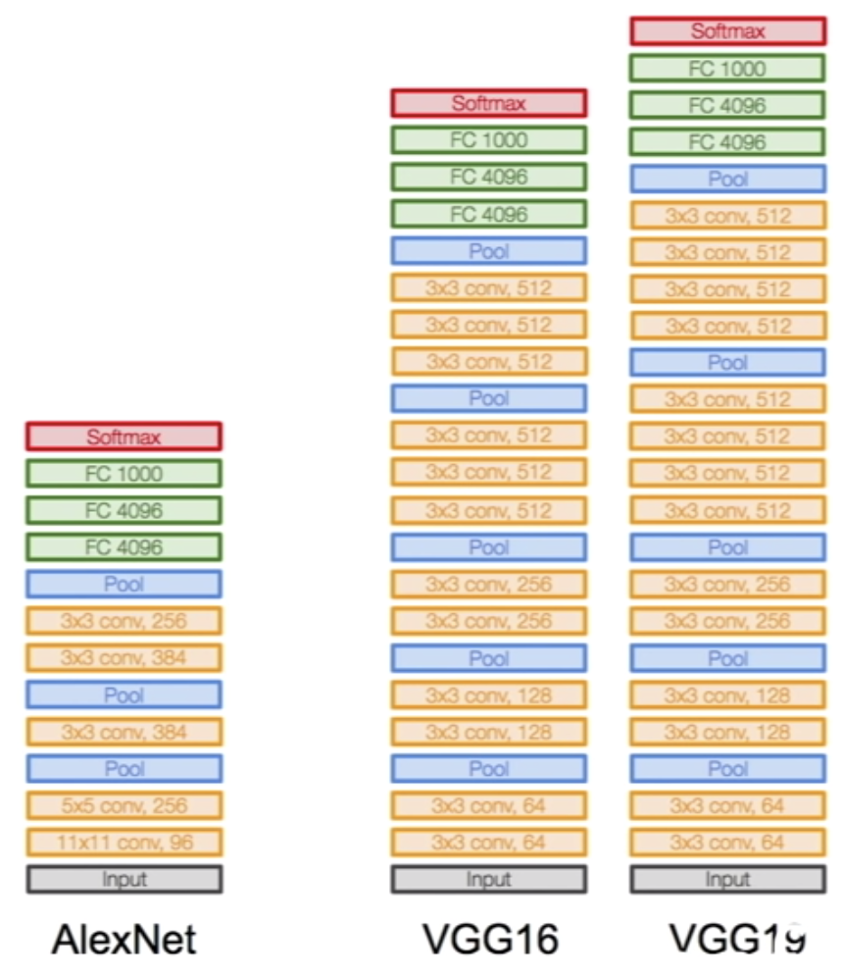
vgg
Design principals
Smaller filters, but deeper
Double channel number after each pool
deeper, more nonlinearities
Double channel number after each pool
Keeps constant compute over depth (pool reduces spatial resolution)
Notes:
Paper: https://arxiv.org/abs/1409.1556

Slide 32
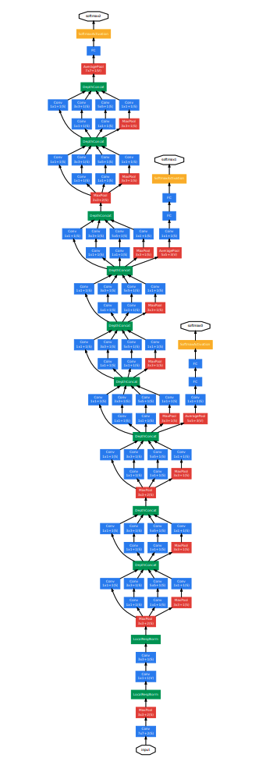
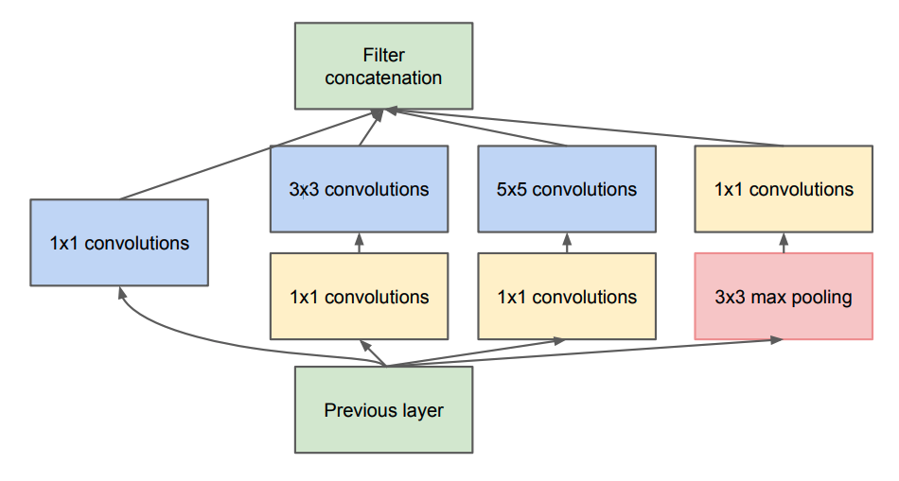
googlenet
Idea: Inception module
Parallel filters
Bottleneck layers
Can reduce depth arbitrarily
Otherwise would require too much computation

Slide 33
googlenet
Some properties
Focuses on efficiency
22 layers
Only 5M parameters
Alex net had 16M parameters, but GoogleNet is deeper

Slide 34
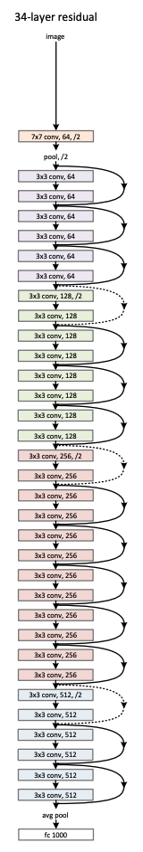
resnet
2 important discoveries, made deep networks trainable
Batch normalization
Residual block
Notes:
Paper: https://arxiv.org/abs/1512.03385

Slide 35
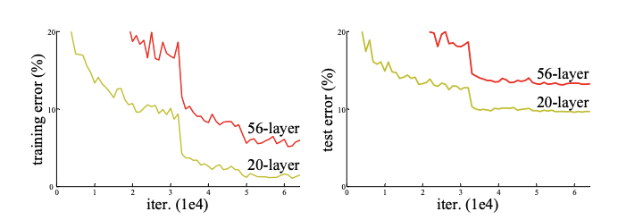
resnet
What they noticed: a deeper net (56 layers) was performing worse than a shallower net (20 layers), but not because of overfitting (because it was performing worse even on the training set)
Hypothesis: it is because deeper net is a harder optimization problem
Idea: don’t learn the mapping, but learn the residual
Residual: what you need to change from the previous representation to achieve the mapping
Notes:
This could explain why ResNet works:
https://arxiv.org/pdf/1805.07477.pdf

Slide 36
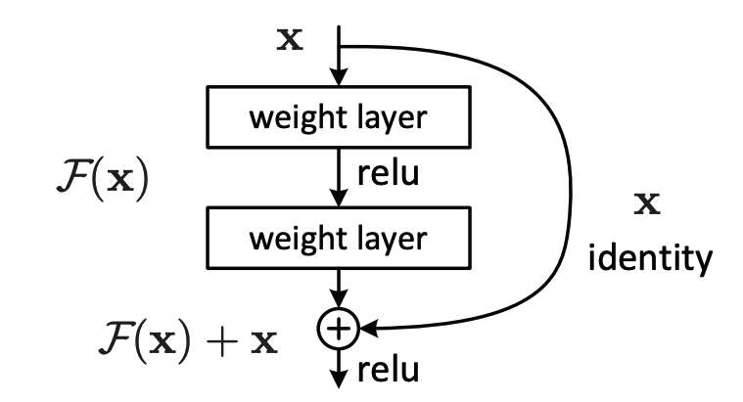

resnet
Learn the residual F(x) of the mapping, intead of the complete mapping H(x)
Desirable properties of skip connection :
Lets gradient flow back to earlier layers
Residual block can easily learn the identity transformation
If all weights are zero -> identity transformation
$$H\left(x\right)=$$
Notes:
This could explain why ResNet works:
https://arxiv.org/pdf/1805.07477.pdf

